Slide 1


Cloud for AI
Course 5: Modelling (Part 2)
Filotas Theodosiou
Notes:
Today we are going to talk about Modelling & Evaluation. The second part of you assignment is about building a ML solution for your problem. As we have talked about many times in this course, the ML solution is not the end-product. Its not what we deliver to customers. Thus, we need to rethink of our ML practises so they are aligned with the business goal we are trying to solve. Thats were we are going to focus today! The course is mostly with theoretical but important concepts. Not a lot of it will be used for the exams but are things that might help you with the assignment and how you approach machine learning problems

Slide 2
Important Concepts!
Notes:
The idea is to present you with some important concepts that you might come across and you need to be prepared to handle.

Slide 3
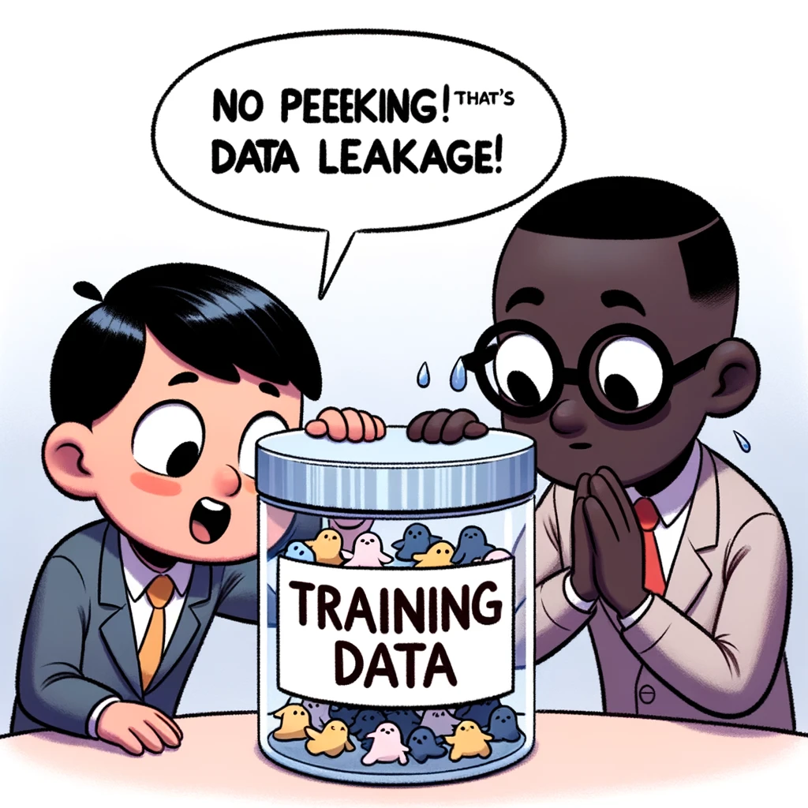
Important Concepts!
Data Leakage
Notes:
First of all we have data leakage. Data leakage is something data scientist come across very often. From research projects, to Machine Learning solutions in applications. Even some of the best researchers in the world had issues of data leakage that messed with their work. We realy realy need to pay close attention here.

Slide 4
Data Leakage
Some form of the label we are trying to predict “leaks” into the features
Information that describes the target variable is “leaked” in our training data
The performance of the model will be higher than its should because it “cheats”
In reality, this information should not be available during inference!
Notes:
What is data leakage?? Data leakage is when our model gets clues about the true label from one or more of our training features when it shouldnt. Its when something that describes the variable we are trying to teach our model to learn is given in the training data. What happenes is that the model might “cheat” and look only at this information. In reality, this information should not available and will not be in the future!

Slide 5
Causes of Data Leakage
Leakage on data collection
Features contain information on the true label because of the way data is collected
Notes:
Finally we have data leakage that occurs during data collection. For example when we collect our data we created many hints to the model to focus on rather than focusing on the task. And we have the example of the doctors I used before.

Slide 6
Data Leakage: Example 1
Problem: detect lung cancer from CT scans
Data: collected from hospital A
Performs well on test data from hospital A
Performs poorly on test data from hospital B
Patient ID | Date | Doctor note | Medical record | Scanner type | CT scan
Notes:
Lets look at an example! This is a real example from a specific application in US some years ago!
We have an application where we train a model to detected lung cancer from CT scans. These are the features we are working with.
Our models performs very well on data from hospital A but fails completely on data from hospital B.
This gets us trigged. Something is realy wrong here. We are trying to understand what is going on by looking and relooking our data.

Slide 7
Data Leakage: Example 1
Problem: detect lung cancer from CT scans
Data: collected from hospital A
Performs well on test data from hospital A
Performs poorly on test data from hospital B
Patient ID | Date | Doctor note | Medical record | Scanner type | CT scan
At hospital A, when doctors suspect that a patient has lung cancer, they send that patient to a higher-quality scanner
Notes:
So after some months, the researchers found what was going. The problem was the Scanner type. Doctors at hospital A send all “high-alert” patients to a specific high quality scanner. So every time the model saw that it had this scanner type as its feature, it flagged it as lung cancer. The model did not look at CT scans. Instead it only focused on the scanner type.

Slide 8
Data Leakage: Example 1
Problem: detect lung cancer from CT scans
Data: collected from hospital A
Performs well on test data from hospital A
Performs poorly on test data from hospital B
Patient ID | Date | Doctor note | Medical record | Scanner type | CT scan
The model puts all its attention to the Scanner Type and not the image.
This is not the case for hospital B.
Patients on higher quality scanner are both likely and unlikely to have cancer
At hospital A, when doctors suspect that a patient has lung cancer, they send that patient to a higher-quality scanner
Notes:
However on Hospital B doctors did not follow the same pattern. They send different types of patients to high quality scanners. So the model flagged all on high quality scanner again as lung cancer and failed completely. This is data leakage. The model got a hint from the environment about the true label that it tried to predict and immidiately tried to cheat. Of course when we changed environments these things did not stand out again.

Slide 9
Causes of Data Leakage
Leakage on data collection
Features contain information on the true label because of the way data is collected
Splitting time-correlated data randomly instead of time
We usually shuffle our data before splitting!
But with time-related features shuffling is not a good option!
Notes:
So what causes data leakage?
We usualy see cases of data leakage on time-related data. Like time series. So when we do the train-test split we first shuffle our data and then keep a part for testing. But what happens is that what will happen if what we are trying to predict is already provided to us from a future time step?

Slide 10
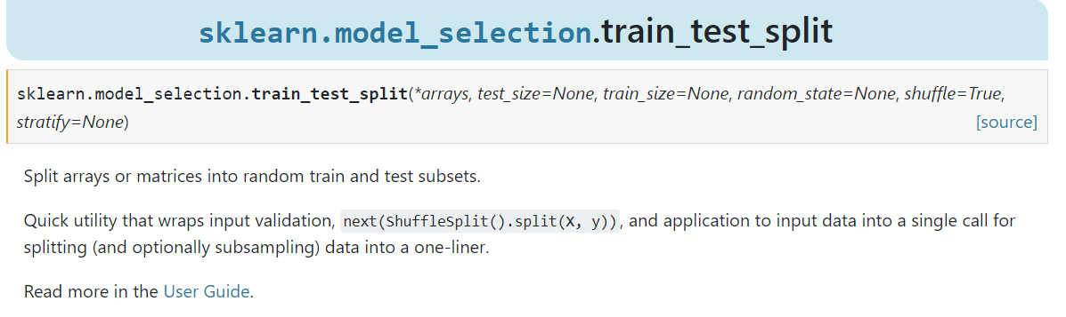
Causes of Data Leakage
Leakage on data collection
Features contain information on the true label because of the way data is collected
Splitting time-correlated data randomly instead of time
We usually shuffle our data before splitting!
But with time-related features shuffling is not a good option!
Notes:
So what causes data leakage?
We usualy see cases of data leakage on time-related data. Like time series. So when we do the train-test split we first shuffle our data and then keep a part for testing. But what happens is that what will happen if what we are trying to predict is already provided to us from a future time step?

Slide 11
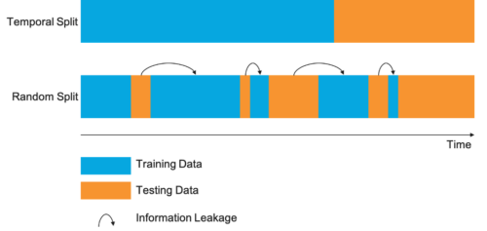
Example of Data Leakage
Application: Weather Forecasting
Data: Weather data from 2017-2022
Randomly shuffle data:
Training set might have data from 2022
Test set might have data from 2017
Problem?Weather is time correlated.
Introducing future information in the past gives the model an advantage
Important:
Always consider the temporal nature of data. Ensure no “future” information leaks into the “past”
Notes:
Lets look at an example. Lets assume we do weather forecasting. We want to predict the weather for the next day. We have data from 2017-2022.
If we do random split as in the second part of the picture we will end having random days for training and test set. For instance we might end up with data from December 2021 in our training set and November 2021 in our test set.
What might happen?
The model might learn that specific patterns that occur after certain dates (For example after November) and stick to these to make predictions. For example if it knows what happens in December 2021 it might find out that Before November there is no rain but after November there is rain. So when it predicts what will happen in November it will know that there is rain. Because it has access to information from 2021 which it shouldnt.
What we do instead?
We always, always split our data based on temporal dimension for this kind of data.

Slide 12
Causes of Data Leakage
Leakage on data collection
Features contain information on the true label because of the way data is collected
Splitting time-correlated data randomly instead of time
We usually shuffle our data before splitting!
But with time-related features shuffling is not a good option!
Data processing before splitting
Use the whole dataset (including test set) to generate global statistics (for normalization)
ALWAYS FIRST TRAIN-TEST SPLIT AND THEN NORMALIZE
Notes:
Another very common cause of data leakage is the following. When we process our data before splitting! This is the most common issue and I have seen it soooo many times. Say want to normalize our data before using our favourite ML model.. Normalization is very important for a number of reasons.- But we should it right.
When we normalize our data before splitting we use information from the test set. And the model learns that!!

Slide 13
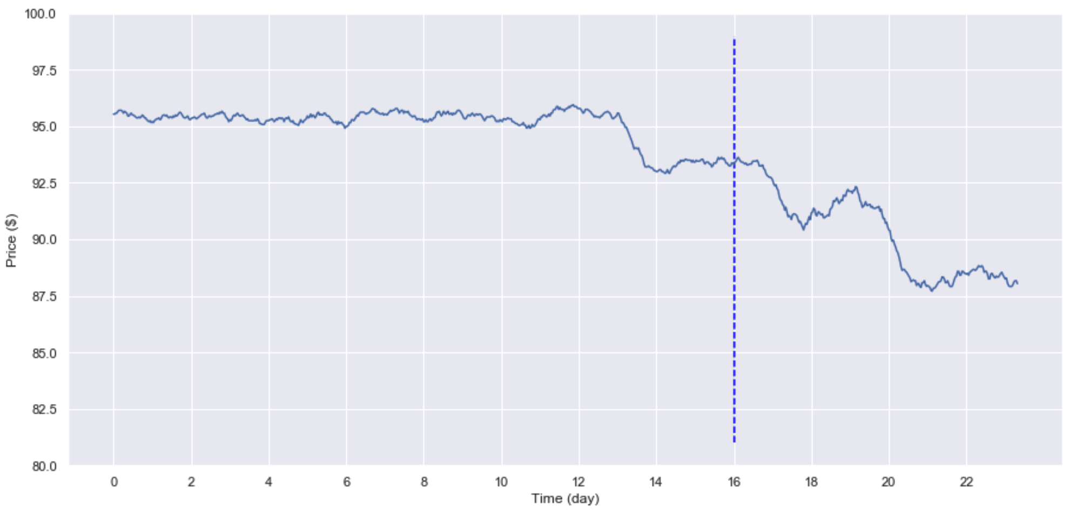
Example of Data Leakage:
Use the whole dataset (including valid/test) to generate global statistics/info
mean, variance, min, max, n-gram count, vocabulary, etc.
Statistics are then used to process test data
scale, fill in missing values, etc.
Train split
Test split
Using the test set for taking the mean, reduces the mean of the training set!
So the model gets a hint that the signal will decrease
mean(train) = 95.141
mean(test) = 90.326
mean(train + test) = 93.538
Notes:
An example. Lets say we take the mean and the variance to do StandardScalling. Lets look at the mean of the train set only, the mean of the test set and the mean of both the train and test set. You can see that when we take the mean of the test set into account (we normalized before splitting) the overall mean is lower than when we take the mean of only the train set. So what happens is that the model was seeing values around the training mean (95) and when there is a small reduction to the line (signal drops to 92 just before the prediction moment) the model knows that the it should be more reduction because the overal mean is 93 and for so long we only saw values around 95. So it predicts to have a drop. However this information will not be present in the real time!!

Slide 14
Example of Data Leakage:
Use the whole dataset (including valid/test) to generate global statistics/info
Instead:
Split your data before scaling/filling in missing values
Split even before any EDA to ensure you’re blind to the test set
Train split
Test split
Using the test set for taking the mean, reduces the mean of the training set!
So the model gets a hint that the signal will decrease
mean(train) = 95.141
mean(test) = 90.326
mean(train + test) = 93.538
Notes:
Remember! Always always split your data before doing anything. The model should not see information from the test set. Well ideally neither should you!! When you deploy your model in the world you wont know what the future looks like!

Slide 15
Causes of Data Leakage
Notes:
Finally we have data leakage that occurs during data collection. For example when we collect our data we created many hints to the model to focus on rather than focusing on the task. And we have the example of the doctors I used before.

Slide 16
Causes of Data Leakage
Leakage on data collection
Features contain information on the true label because of the way data is collected
Splitting time-correlated data randomly instead of time
We usually shuffle our data before splitting!
But with time-related features shuffling is not a good option!
Data processing before splitting
Use the whole dataset (including test set) to generate global statistics (for normalization)
Notes:
These are the main reasons for data leakage. You should be very careful with these as the performance on your test set might be good but the performance on the real world might be extremely bad! And we said, we care about creating value on the real world, not focusing on a specific metric and try to minmize a specific score.

Slide 17
How to detect leakage?
Measure correlation of a feature with labels
Example with the CT scanner
Trial - Error
If removing a feature causes the model performance to decrease significantly, figure out why
Monitor model performance as more features are added
Sudden increase: either a very good feature or leakage: usually its leakage :’)
Notes:
How to detect data leakauge? Unfortunately there is no metric or any test that will detect that there is data leakage. We have to find it out on ourselves through trial and error. In some sense that why we investigate our data before building our model. We are trying to understand the connections in our dataframe.
For example in the example with CT scanner, if we have simply plotted the correlation between the CT Scanner and the labels we would have seen the huge correlation and we would be able to correct it!
Most of the times we will detect data leakage after testing our model or when we do model selection. For example if you remove or add a feature and you see huge performance differences (some performance difference is ok but not too much) then unfortunately for you you might have data leakage on your example. Be very, very careful and continuously monitor these situations.

Slide 18
Model Selection & Feature Engineering
Notes:
Oke now lets move to the next important concept. Model selection. What model to select to design our solution. This is a very important case in the era we are living. Why?

Slide 19
The Gold Rules for Model selection
Start with the simplest models.
Avoid the social media “hype” traps
Evaluate deployment tradeoffs
Trust Battle - Tested Models
Combine models => Ensembling!
Notes:
I ll give you some tips for picking your models!
First of all, try to avoid the social media hype traps. People on Linkedin, twitter, (sometimes) reddit etc only post what they believe will give them more likes. Technical influencers make way more posts than experienced data scientists and engineers. These people focus on making products. So do not trust everything you see.
2) Always start simple!!! Thats what we discussed in the previous lectures. Always have benchmarks. ALWAYS. And simple benchmarks. Start very simply and steadily increase your complexity until you reach a point that you no longer improve. Thats your model!! Whats the point in using ResNet with 66M parameters that takes away inference and money when I can do the job with a model with 1.000 parameters!
3) Evaluate tradeoffs! as we said a complex model requires more money for training and monitoring and might have slower inference! There is always a tradeoff!
4) Combine models!! Combine models with different strengths to get the boost of both worlds! We will talk about this in a while. Ensembling is an extremely helpful method for always squeezing a 5% to 10% improvement.

Slide 20
The Gold Rules for Model selection
Start with the simplest models.
Avoid the social media “hype” traps
Evaluate deployment tradeoffs
Trust Battle - Tested Models
Combine models => Ensembling!
Notes:
I ll give you some tips for picking your models!
First of all, try to avoid the social media hype traps. People on Linkedin, twitter, (sometimes) reddit etc only post what they believe will give them more likes. Technical influencers make way more posts than experienced data scientists and engineers. These people focus on making products. So do not trust everything you see.
2) Always start simple!!! Thats what we discussed in the previous lectures. Always have benchmarks. ALWAYS. And simple benchmarks. Start very simply and steadily increase your complexity until you reach a point that you no longer improve. Thats your model!! Whats the point in using ResNet with 66M parameters that takes away inference and money when I can do the job with a model with 1.000 parameters!
3) Evaluate tradeoffs! as we said a complex model requires more money for training and monitoring and might have slower inference! There is always a tradeoff!
4) Combine models!! Combine models with different strengths to get the boost of both worlds! We will talk about this in a while. Ensembling is an extremely helpful method for always squeezing a 5% to 10% improvement.

Slide 21
The importance of Baselines
As mentioned in the previous courses:
The most important step before modeling is to build a Baseline!!
Notes:
We have talked two lectures ago about the importance of building good baselines for evaluating the performance of the model. And I told you before, increase complexity steadily!

Slide 22
The importance of Baselines
As mentioned in the previous courses:
The most important step before modeling is to build a Baseline!!
Consider the application: Predict the demand for ice-creams given past sales.
Notes:
Lets consider an example. A company comes to us and tells us, lets build an application that predicts the demand of ice-creams

Slide 23

The importance of Baselines
As mentioned in the previous courses:
The most important step before modeling is to build a Baseline!!
Consider the application: Predict the demand for ice-creams given past sales.
I spend one week building the most advanced Deep Learning Neural Network
I compare it with the simplest model (a linear regression)
The performance is equal!!!
They are mad!
Notes:
So this company comes, they give me their data and they ask me what they want to find out is how many ice creams they will sell tomorrow. So what I do, is I spend one week, read papers, articles, try- different things and finally build the best Deep Learning Model I can imagine. Its the latest technology etc. So I give this to the company and they compare it with their very simple linear regression. What they find out is that the performance is equal!
So they spend money and 1 full week just to get equal performance. They are mad!!

Slide 24
The importance of Baselines
As mentioned in the previous courses:
The most important step before modeling is to build a Baseline!!
Consider the application: Predict the demand for ice-creams given past sales.
I spend one week building the most advanced Deep Learning Neural Network
I compare it with the simplest model (a linear regression)
The performance is equal!!!
They are mad!
I spend one hour building the simplest baseline
It achieves good enough performance for them
I spend 1 more day and improve the performance a bit based on the mistakes of the first model
They are very happy!
Notes:
Then there comes another guy. Again, they give him the same data and ask him to do the same task. So what he does is he takes the simplest model, a linear regression, it tests it, it finds what he can do to improve it. It improves the model a bit by adding some extra features and within 1 day he has a good enough solution for the companies.They are very happy!!

Slide 25
Start with the simplest models
Easier to deploy
Deploying early allows for other team members to improve other pipelines
Easier to debug
Easier to improve once understood errors
Careful!! Simplest models != easiest to run
You can run an LLM with 2 clicks.
More on that later
Notes:
And a quick tip here. Do not confuse simple models with models that are easy to run. I have shown you have easy it is to build use a LLM from hugging face with just 20 lines of code. Sometimes we need models to run fast, sometimes we need models to have a low number of parameters. Try to understand the situation before spending resources!

Slide 26
Tips for Model selection
Start with the simplest models.
Avoid the social media “hype” traps
Evaluate deployment tradeoffs
Trust Battle - Tested Models
Combine models => Ensembling!
Notes:
Oke, lets take everything step by step.

Slide 27
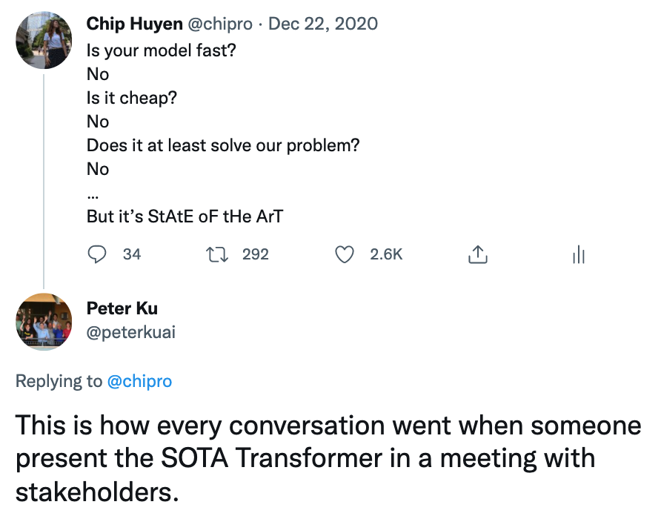
The “State of the Art” traps
SOTA’s promise
Why use an old solution when a newer one exists?
It’s exciting to work on shiny things
Marketing
Deep Learning is fun
Notes:
The problem with SOTAs is that its a big trap. State of the art on a specific dataset is a much, much different story than your own data. Also, SOTA models most of the times are a lot more complex than normal models. That means they cost more and they have higher latency.
simple and established models on the other hand, models that exist for years have proven their succses and have strong community back up. For a reason! Because they work! When we get information that the new SOTA is battle-tested and it works, of course we are going to use it in our pipeline! We are not stupid.

Slide 28
The “State of the Art” traps
SOTA’s promise
Why use an old solution when a newer one exists?
It’s exciting to work on shiny things
Marketing
Deep Learning is fun
SOTA’s reality
SOTA on research data != SOTA on your data
Cost
Latency
Proven industry success
Community support
Notes:
People publish papers and write articles using their favourite word: State of the Art. What is State-of-the-Art? A model that achieved the highest accuracy on a specific metric on a specific dataset!!
And I know deep learning is fun, we want to build new models with the newest things out there, we want to use all the nice stuff etc

Slide 29
Tips for Model selection
Start with the simplest models.
Avoid the social media “hype” traps
Evaluate deployment tradeoffs
Trust Battle - Tested Models
Combine models => Ensembling!
Notes:
Simple models!
Lets see

Slide 30
Evaluate tradeoffs
 | Research | Production
Objectives | Good Model Performance | Different Managers -> Different Objectives
Computational priority | Not this important. | Fast. Users should be happy.
Data | Static -> Fixed Dataset | Constantly changing (possibly daily)
Fairness | Good to have (sadly) | Important
Interpretability* | Good to have | Important
Notes:
Always alwasy consider the tradeoofs when you do model selection. Accuracy is not the most important thing. Its important but not the only important thing. Never forget that. Focus on tradeoffs. These are some of the tradeoffs we have talked about. All of these are very important and we need to consider them.

Slide 31
Evaluate tradeoffs
 | Research | Production
Objectives | Good Model Performance | Different Managers -> Different Objectives
Computational priority | Not this important. | Fast. Users should be happy.
Data | Static -> Fixed Dataset | Constantly changing (possibly daily)
Fairness | Good to have (sadly) | Important
Interpretability* | Good to have | Important
Notes:
Always alwasy consider the tradeoofs when you do model selection. Accuracy is not the most important thing. Its important but not the only important thing. Never forget that. Focus on tradeoffs. These are some of the tradeoffs we have talked about. All of these are very important and we need to consider them.

Slide 32
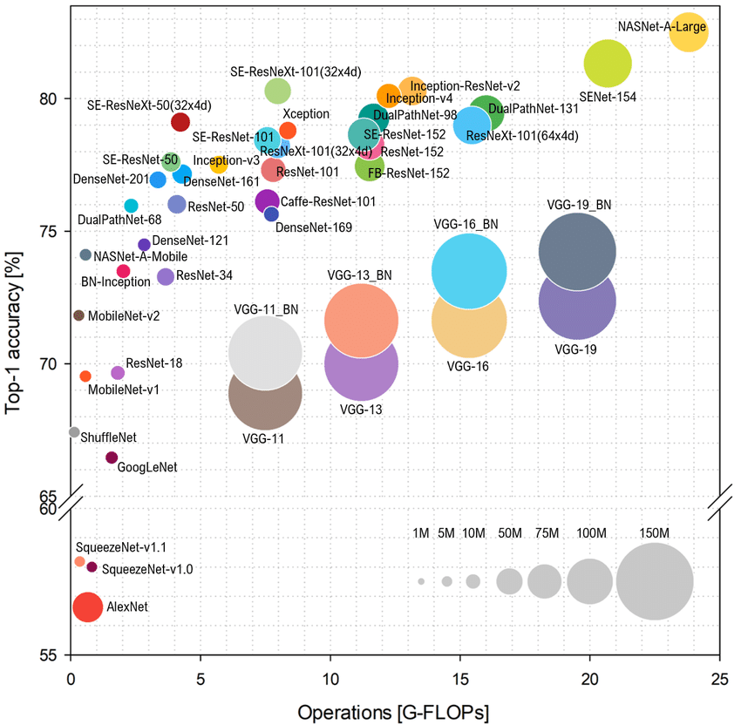
Evaluate tradeoffs
More parameters mean higher accuracy
More parameters also mean more computation complexity
This is not research.
There are tradeoffs!
Notes:
Always alwasy consider the tradeoofs when you do model selection. Accuracy is not the most important thing. Its important but not the only important thing. Never forget that. Focus on tradeoffs. These are some of the tradeoffs we have talked about. All of these are very important and we need to consider them.

Slide 33
Tips for Model selection
Start with the simplest models.
Avoid the social media “hype” traps
Evaluate deployment tradeoffs
Trust Battle - Tested Models
Combine models => Ensembling!
Notes:
Simple models!
Lets see

Slide 34
What The Media Does Not Tell You.
Large Language Models (LLMs) are all over the news.
And for a good reason.
They dominate on Natural Language, Audio and Vision tasks.
Notes:
Lets look at some evidence know. It is true that LLMs are great. They solve all NLP tasks way more easy and accurately than any other model!
However this is for NLP only!
According to Kaggle reports, the most widely applied models out there are Random Forest, GBDTs and simple models. Why? Ill
Because in industry we have structured tabular data! And thats where these models excel! We have evidence for that.
Kaggle CEO framed it like that to make the description.

Slide 35
What The Media Does Not Tell You.
Large Language Models (LLMs) are all over the news.
And for a good reason.
They dominate on Natural Language, Audio and Vision tasks.
But this is not what the industry wants:
Industry deals mostly with structure (Tabular) data
“Traditional” ML models have dominated applied ML competitions
“Traditional” ML models are widely applied in practise
Notes:
Lets look at some evidence know. It is true that LLMs are great. They solve all NLP tasks way more easy and accurately than any other model!
However this is for NLP only!
According to Kaggle reports, the most widely applied models out there are Random Forest, GBDTs and simple models. Why? Ill
Because in industry we have structured tabular data! And thats where these models excel! We have evidence for that.
Kaggle CEO framed it like that to make the description.

Slide 36
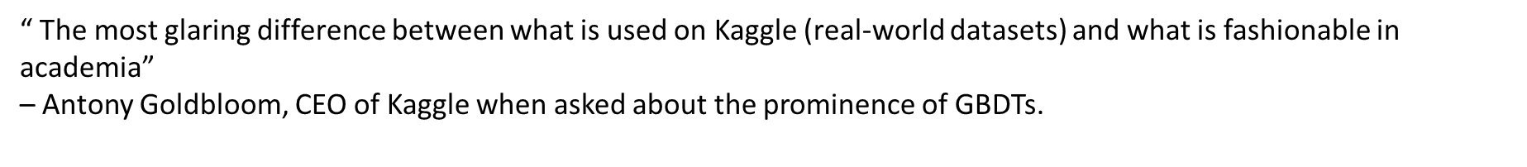
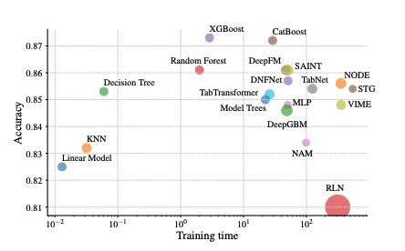
What The Media Does Not Tell You.
Notes:
Lets look at some evidence know. It is true that LLMs are great. They solve all NLP tasks way more easy and accurately than any other model!
However this is for NLP only!
According to Kaggle reports, the most widely applied models out there are Random Forest, GBDTs and simple models. Why? Ill
Because in industry we have structured tabular data! And thats where these models excel! We have evidence for that.
Kaggle CEO framed it like that to make the description.

Slide 37
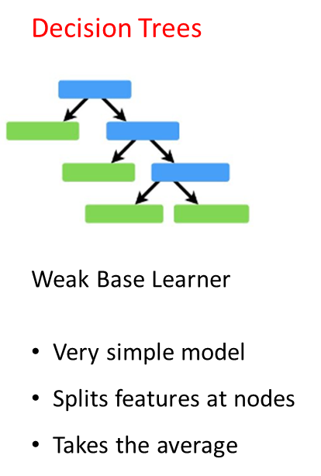
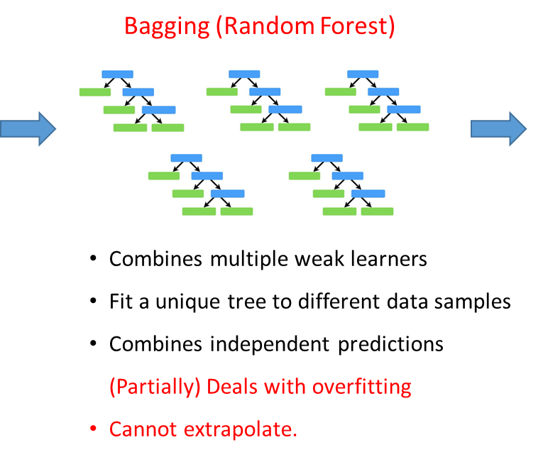
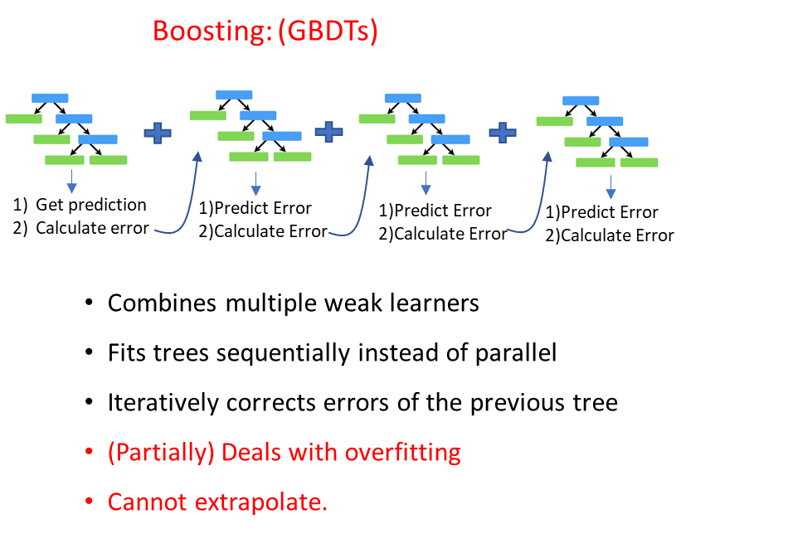

A (small) introduction to GBDTs
Notes:
Describe the slide.
Name the three models!

Slide 38
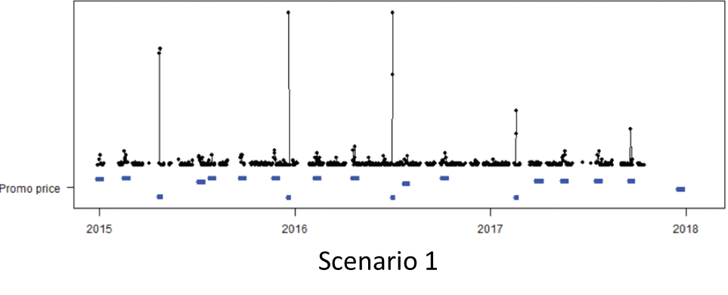
Why XGBoost Works on Tabular Data?
Feature Engineering: Curate (fix) your data is the key to good model performance!
Good data > A lot of bad data
Good data = Features that describe the problem!
Sales of a product!
Notes:
Oke. Now lets discuss how we can make these model work for us.
Say good data > lots of data
Say whats good data
Take this example now. We have some peaks here and we have zero idea why they are happenning
Describe the examples

Slide 39
Why XGBoost Works on Tabular Data?
Feature Engineering: Curate (fix) your data is the key to good model performance!
Good data > A lot of bad data
Good data = Features that describe the problem!
Sales of a product!
How can a model understand these peaks in the demand and then predict them?
Notes:
The same will be true for the model. How can the model understand what is happening here? How can we expect for our model to understand these peaks and predict them?

Slide 40
Why XGBoost Works on Tabular Data?
Feature Engineering: Curate (fix) your data is the key to good model performance!
Good data > A lot of bad data
Good data = Features that describe the problem!
Sales of a product!
How can a model understand these peaks in the demand and then predict them?
Provide with extra data that these days had a big discount
Notes:
Thats what I mean with good data. So the peaks are on promotions. Every time there is a promotion, there is a peak! If the model sees that, it will predict it!

Slide 41
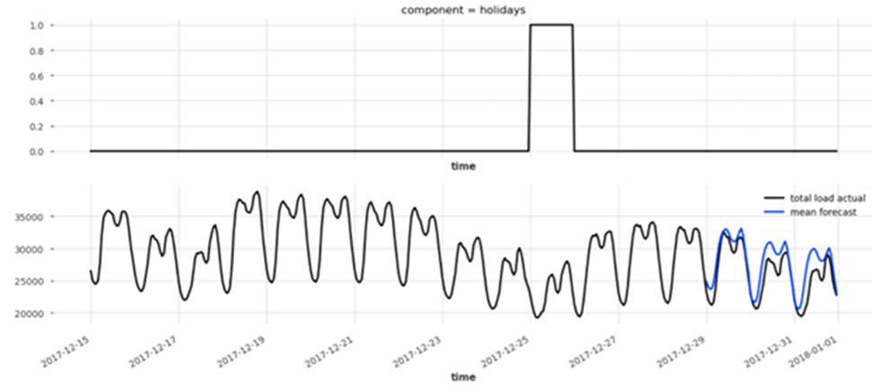
Why XGBoost Works on Tabular Data?
Feature Engineering: Curate (fix) your data is the key to good model performance!
Good data > A lot of bad data
Good data = Features that describe the problem!
Sales of a product!
How can a model understand the drop in the middle of the time series and predict it?
Notes:
Another example

Slide 42
Why XGBoost Works on Tabular Data?
Feature Engineering: Curate (fix) your data is the key to good model performance!
Good data > A lot of bad data
Good data = Features that describe the problem!
Sales of a product!
How can a model understand the drop in the middle of the time series and predict it?
Provide with extra data that these days are holidays!
Notes:
describe it

Slide 43
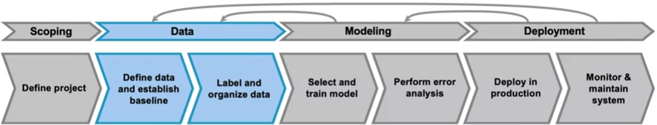
How to come up with good features
Sit together with the business team and understand what features describe the problem!
Try to collect as much of this data as possible!
Build strong features!
Careful for Data Leakage
Notes:
Ok so what we have so far. Its very important for Machine learning tasks to build good features. This is a small template on how to do that.
We start at the data stage. We sit down with the business team and we brainstorm everything that might influence our task. Then we collect as much of this data as possible. We analyze it, we find connections and we make new features!! However we always should be careful for data leakage. Its of extreme importance!!

Slide 44
What if I Work With Unstructured Data?
Deep Learning Models (CNNs, Transformers etc) dominate vision, text and audio tasks.
However training them from scratch is not feasible
They are data hungry
They require expertise
They want computation resources.
Notes:
describe it

Slide 45
What if I Work With Unstructured Data?
With unstructured task, there is core that remains the same. Words have the same meaning everywhere, images too.
Fine Tuning:
The process of taking an existing deep learning model and continue training on some new data of your own tasks.
Transfer Learning:
The process of freezing most of the neural network’s state and retrain the last layer with new data. The goal is to make the model perform slightly different or better on your own task.
Notes:
describe it

Slide 46
What if I Work With Unstructured Data?
Where to find all these models?
Notes:
describe it

Slide 47
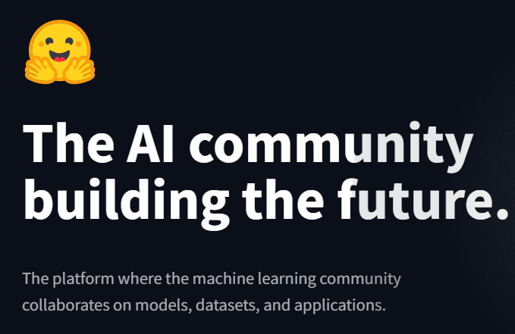
What if I Work With Unstructured Data?
Hugging Face!!
Where to find all these models?
A platform that offers a vast repository of pretrained models, datasets etc.
It spans across various domains (e.g., NLP, vision)
It provides a user-friendly tools for implementing transfer learning or fine-tuning, making
It is a go-to resource for quickly adapting models to your specific tasks.
Notes:
describe it

Slide 48
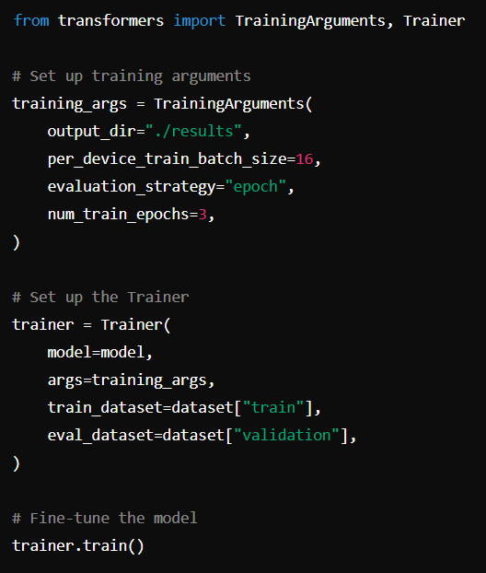
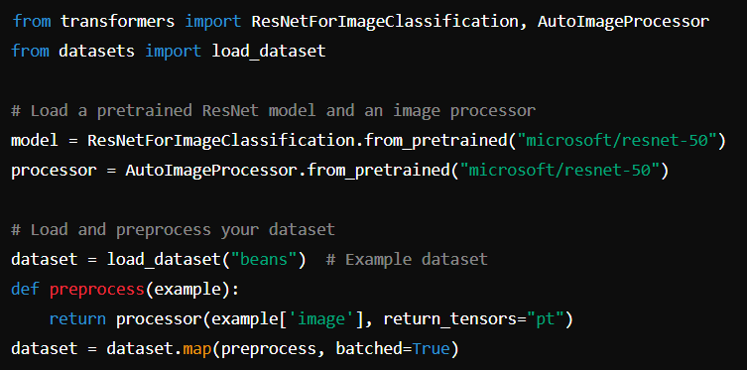
What if I Work With Unstructured Data?
It's that simple!

Slide 49
Tips for Model selection
Start with the simplest models.
Avoid the social media “hype” traps
Evaluate deployment tradeoffs
Trust Battle - Tested Models
Combine models => Ensembling!
Notes:
Simple models!
Lets see

Slide 50
The idea of Combining
Ensembles = Combinations of multiple models!
Notes:
So what is an ensemble? Ensemble is a combination of multiple models. Pretty simple, pretty straighforward

Slide 51
The idea of Combining
Ensembles = Combinations of multiple models!
In every prediction problem we look for a “good-enough” model
A non-trivial, difficult and boring task
Why not avoid it?
Notes:
So whats the idea? The idea is that when we do model selection we usually look for the best “good-enough” model for our task. This is what I have been describing all day. Lets be honest, this is a highly non-trivial, difficult and usualy boring task. And we do not have enough time for that.

Slide 52
The idea of Combining
Ensembles = Combinations of multiple models!
In every prediction problem we look for a “good-enough” model
A non-trivial, difficult and boring task
Why not avoid it?
Combinations:
Instead of looking for the “best-model” combine multiple predictions
Ensemble:
A strong model from an ensemble of weak models (referred to as base learners)
Notes:
And thats the idea of ensembling! Instead of looking of the best good-enough model we combine multiple predictions. An ensemble is a strong model that is the combination of multiple weaker models refered to as base learners. Pretty straighforward right?

Slide 53
Ensembles Evidence
Notes:
Ok yeah you might not believe me here. You might still want to try to tune all parameters and go and find the best model out there. Let me give you some evidence.

Slide 54
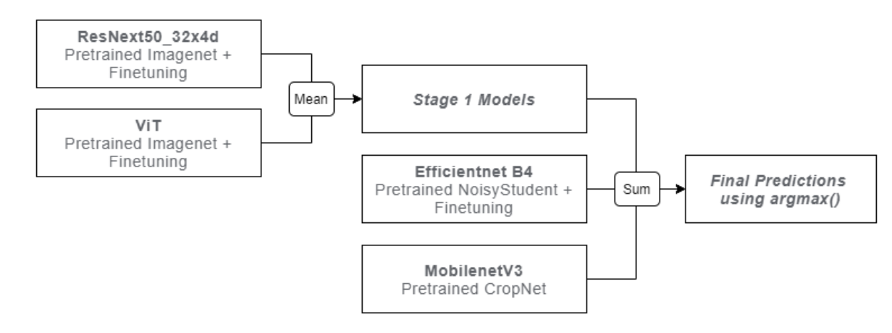
Ensembles Evidence
20/22 winning solutions on Kaggle in Jan - Aug 2021 use ensembles
One solution uses 33 models!
https://farid.one/kaggle-solutions
Notes:
So in Kaggle, 20 of the 22 winning solutions on kaggle competitions uses ensembles. SUprisingly one solution even has 33 models. And this is a trend that perceives. In my experience and what I found out after talking with other data scientists is that ensembling always returns a 5%-10% performance boost! And on top of that, it almost never returns reduced performance. Thats cool righ?

Slide 55
Why does ensembling work?
Task: email classification (SPAM / NOT SPAM)
3 uncorrelated models, each with accuracy of 70%
Ensemble: majority vote of these 3 models
Ensemble is correct if at least 2 models are correct
Notes:
Ok lets take an example to understand what we have here. Just read the example here

Slide 56
Why does ensembling work?
3 models, each with 70% accuracy
Ensemble is correct if at least 2 models are correct
Outputs of 3 models | Probability | Ensemble’s output
All 3 are correct | 0.7 * 0.7 * 0.7 = 0.343 | Correct
Only 2 are correct | (0.7 * 0.7 * 0.3) * 3 = 0.441 | Correct
Only 1 is correct | (0.3 * 0.3 * 0.7) * 3 = 0.189 | Wrong
None is correct | 0.3 * 0.3 * 0.3 = 0.027 | Wrong
Notes:
Say we have a new email coming. Lets investigate the probabilities for each scenario given what each model predicts.

Slide 57
Why does ensembling work?
3 models, each with 70% accuracy
Ensemble is correct if at least 2 models are correct
Probability at least 2 models are correct: 34.3% + 44.1% = 78.4%
Outputs of 3 models | Probability | Ensemble’s output
All 3 are correct | 0.7 * 0.7 * 0.7 = 0.343 | Correct
Only 2 are correct | (0.7 * 0.7 * 0.3) * 3 = 0.441 | Correct
Only 1 is correct | (0.3 * 0.3 * 0.7) * 3 = 0.189 | Wrong
None is correct | 0.3 * 0.3 * 0.3 = 0.027 | Wrong
Notes:
Lets consider the probabilities. So 78.4% of the times the ensemble will return a correct result! Thats an 8% improvement from using any of the base models!! Nice right?

Slide 58
Why does ensembling work?
3 models, each with 70% accuracy
Ensemble is correct if at least 2 models are correct
Probability at least 2 models are correct: 34.3% + 44.1% = 78.4%
The less correlation among base learners, the better
Common for base learners to have different architectures
Notes:
Some quick tips here for when designing ensebmles. The less correlation there exist between your base model, the better! Why? Because different models will investigate different aspects ofthe same problem and when you combine you get a nice overview of what works and what does not! So its very common for base learners to have different architecture between each other! For example we might have a Neural Network, a simple ML model and a more complex Neural Network

Slide 59
Takeaway on Model Selection.
Start simple and scale up until you reach your performance goal
Do not fall for the “hype” on social media and the State-of-the-art research performance
Trust what works
Gradient Boosted Decision Trees (GBDTs) on Tabular Data
Pretrained Models from Hugging face for structured tasks
Ensemble your models.
Notes:
So what is an ensemble? Ensemble is a combination of multiple models. Pretty simple, pretty straighforward

Slide 60
Time for discussion!
Notes:
Oke now lets discuss a bit.

Slide 61
An exercise!
Duolingo is a platform for language learning. When a student is learning a new language, Duolingo wants to recommend increasingly difficult stories to read.
What features would you use to measure the difficulty level of a story?
Hint: Think of a sentence in Dutch with 3 words and another with 20. Which is the most difficult?
Do “hard” words appear more or less in a a difficulty story compared to an easy one?
How can you measure how hard a sentence is then??
Given a story, how would you edit it to make it easier or more difficult?
Notes:
Do you know duolingo?? Is a platform where people go and learn a new language. You learn the grammar the vocabulary and the structure of new languages. So in duoloingo when you cross levels you get suggestions to read new stories so you improve your understanding. The question is, how does duolingo know what a good story is??
Vocabulary -> more complex words
Grammar -> more difficult grammar
Increase or decrease the vocabulary complexity! Try to make them thing of it. If they can tell them grammar is one idea. How would you measure more difficult vocabulary?

Slide 62
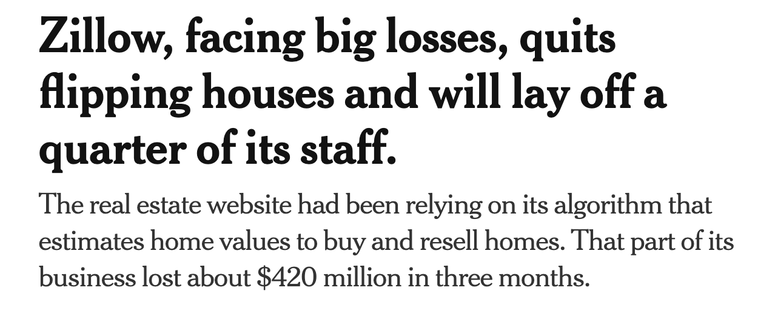
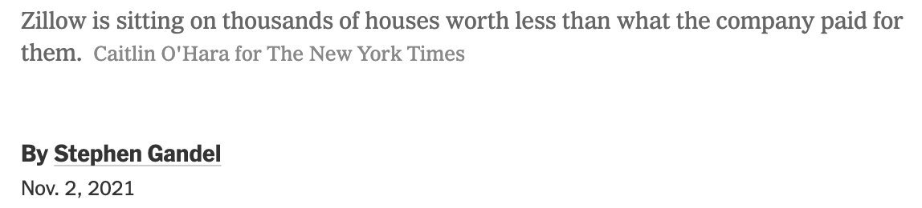
An second exercise!
What went wrong with Zillow Offers?
Notes:
Lets consider another example. Zillow is a real estate website that hired a very good Data Science team to handle their forecasting!
What happened? They lost 420 million dollars in three months and fired 80% of their staff!

Slide 63
A second exercise!
What was Zillow doing?
A very big real estate company!
Use ML to predict the future price of houses
Find houses that are “bargains”. They can buy now cheap and then sell more expensive
ML model over-predicted the house prices!
Zillow bought houses at higher prices than they should!
Notes:
How they worked:
-They forecast the future price of a house
-Then they pick the point to buy it by considering the forecast.
-They wanted to buy cheap and then sell big!

Slide 64

Bad modelling practises!
What happened to Zillow?
Zillow invested in houses much more than their actual price
Why?
Their model predicted all houses higher than the true value
(overestimated)
How?
Zillow’s model did not account for:
Dynamics of housing market: Prices change per year!!
Local patterns: The same house in Brugge is more expensive than in Kortrijk
What would you do to fix these issues?

